Slide 1


Block Gradient Descent Algorithm for Distributed Detection in Massive MIMO
Yunjie Chen, Qiqiang Chen, Lanxin He, Zheng Wang
Southeast University
2025.10.18

Slide 2

Contents
01
Introduction
02
System model
03
The proposed BGD algorithm
04
Complexity analysis & Simulations

Slide 3
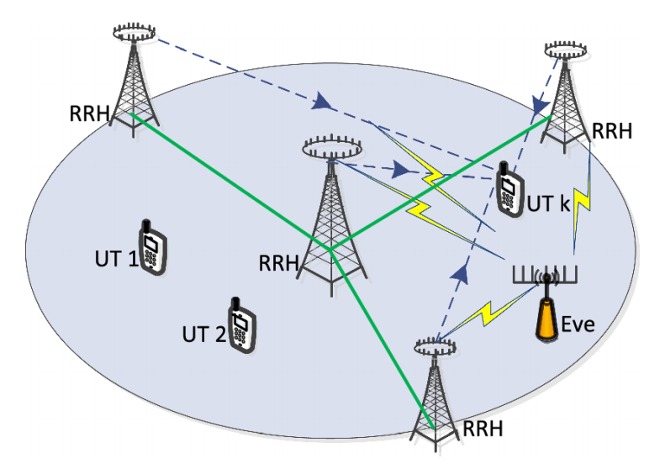
1 Introduction
Distributed detection schemes for massive MIMO
To address the challenge of transferring and computing vast volumes of data in centralized detection
Storing information and detecting signals in distributed units (DUs)
Problems of distributed detection algorithm
Proper architecture should be introduced to organize DUs.
Bit error rate (BER) performance of the algorithm needs to approach that of centralized detection schemes like ZF and MMSE, although without complete channel information.
The algorithm needs to have low computational complexity due to the increasing number of antennas.
Notes:
1 problem感觉优点生硬
2 图片里面的符号不符合本文章
1 nr>>nt

Slide 4
1 Introduction
Our work: extending stochastic gradient descent (SGD) algorithm
Flexible numbers of DU antennas
Dynamic step size and ring architecture
Make the algorithm applicable to a variety of practical scenarios
Guarantee the algorithm converge to the solution of linear detection schemes
The proposed block gradient descent (BGD) detection algorithm

Slide 5

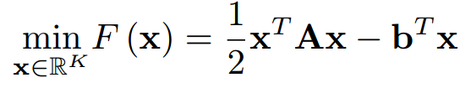

2 System model
The received vector
The transmitted vector , is an ASK constellation set
The equivalent Rayleigh channel matrix
The Gaussian noise vector
A real-valued uplink MIMO system
Traditional linear ZF detection
A convex optimization problem
the global gradient

Slide 6
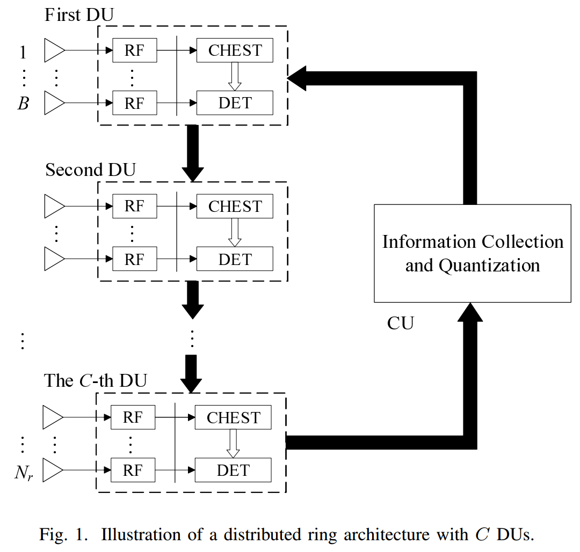
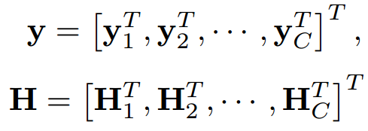




2 System model
Iterative process of signal detection in DUs
More iteration loops
instead of (daisy-chain architecture)
The local gradient of the c-th DU:

Slide 7


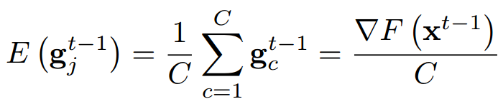

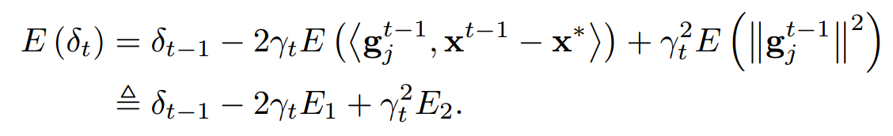
3 The proposed BGD algorithm
How to select the step size?
dynamic step size
different from single DU antenna in SGD
Convergent or not?
To simplify convergence analysis, an assumption is proposed:
Each DU is selected to update with the same probability .
Some notations
: the maximum eigenvalues of
: the minimum eigenvalues of
Rewrite the updating formula
Take the inner product on both sides
Take the expectation on both sides
Notes:
1 order?

Slide 8
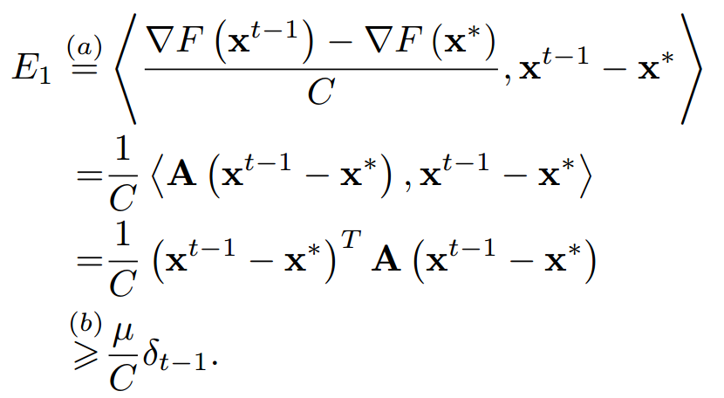
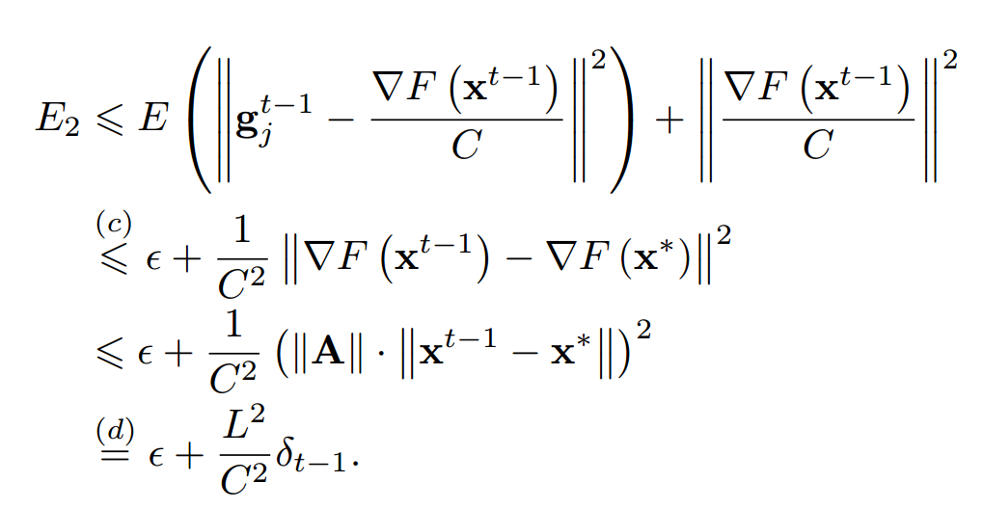

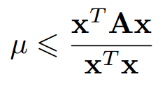
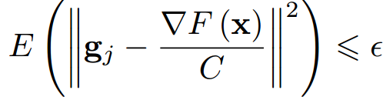
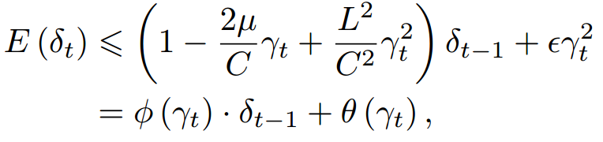
3 The proposed BGD algorithm
As for E₁
As for E₂
(a) holds by the assumption and
(c) holds because the statistic variance of local gradient has an upper bound, i.e.
(b) follows
(d) holds because is a symmetric matrix.
Therefore, we can obtain

Slide 9


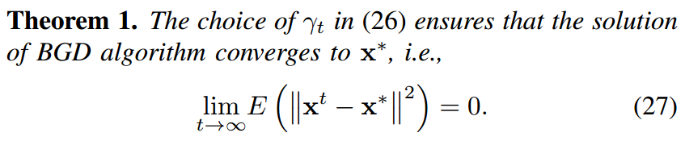
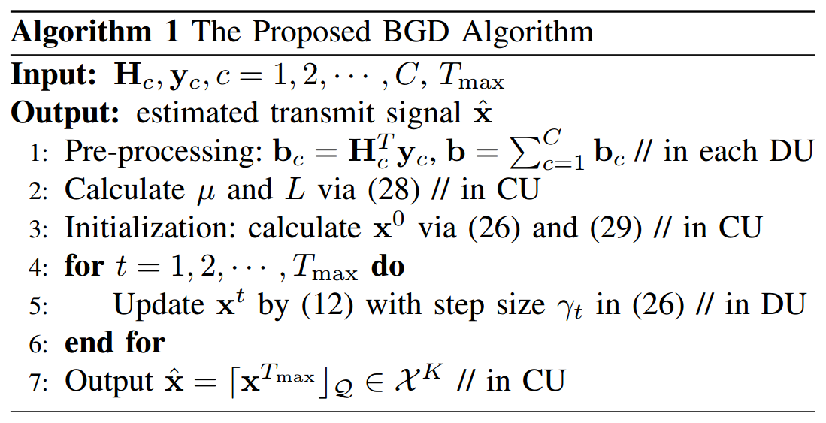
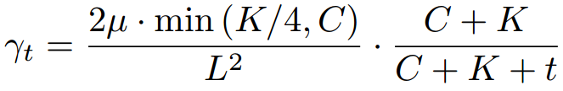
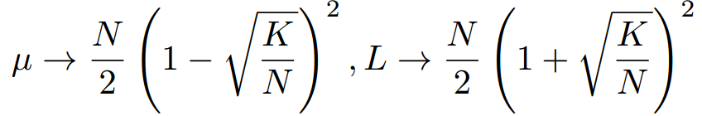

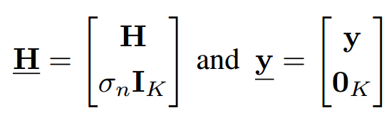
3 The proposed BGD algorithm
Then, by setting and ensuring decay to zero, we come to theorem 1.
The algorithm are summarized as follows.
Values of primary parameters
Step size
Eigenvalues
Initial solution
Additionally, can be transformed to MMSE solution by extending and as

Slide 10
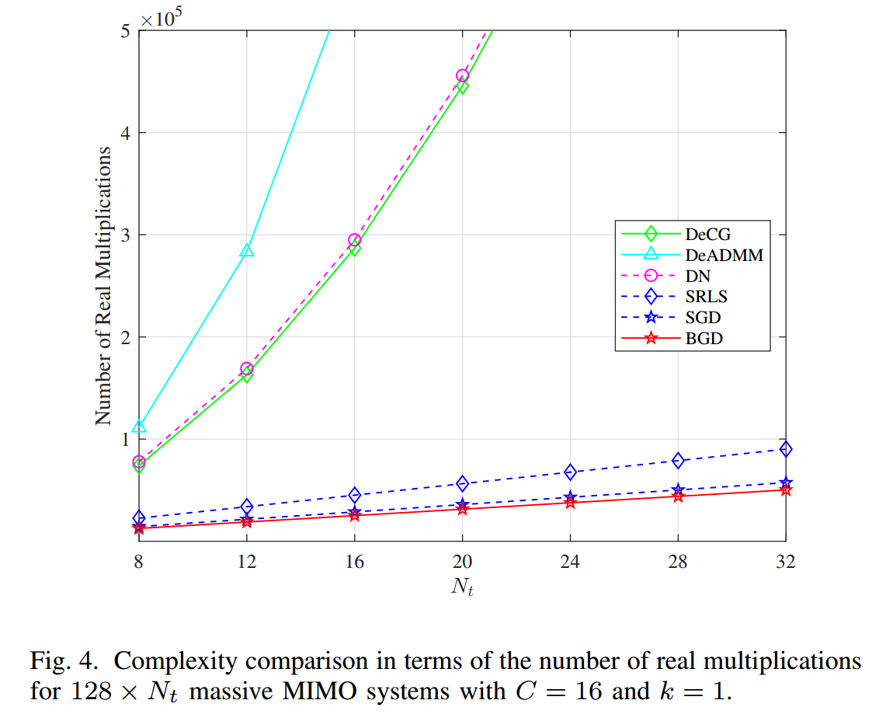

4 Complexity analysis
The computational complexity is evaluated in terms of the required number of real multiplications.
Computing in each DU costs NK, obtaining costs K.
Computing costs 2QK, which is less than computing first.
Multiplying with costs K.
The total computational complexity is , namely .
The data bandwidth cost is K, as only needs to be conveyed.

Slide 11
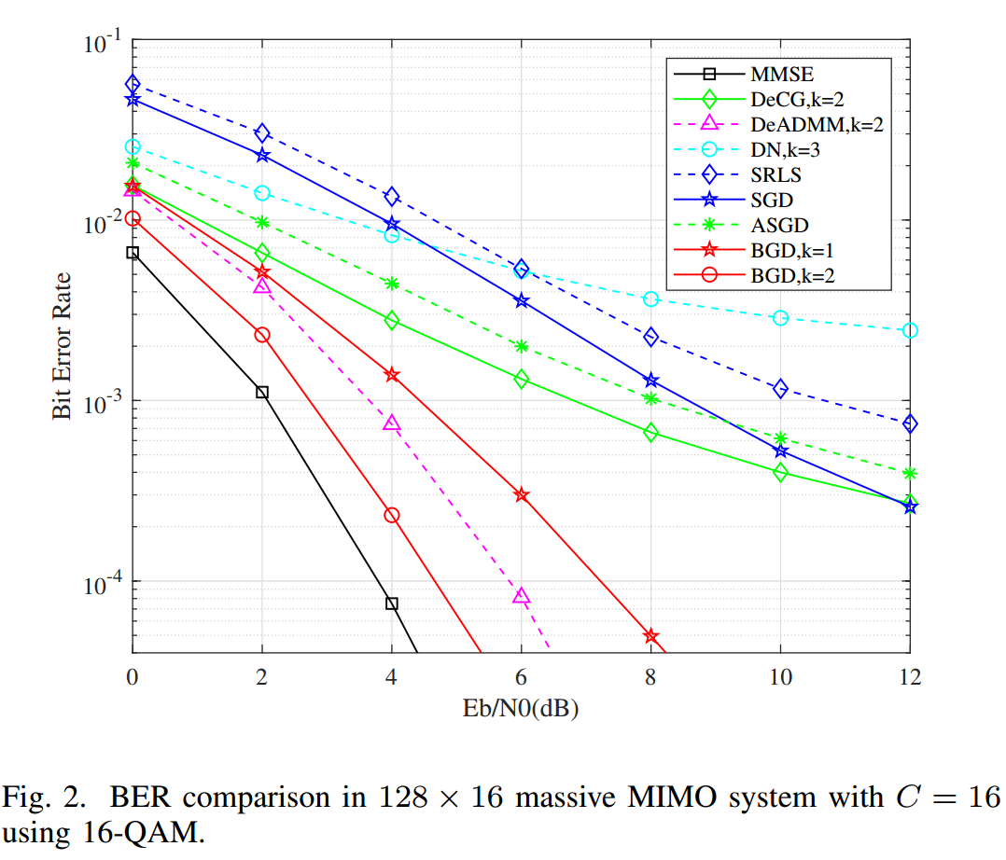
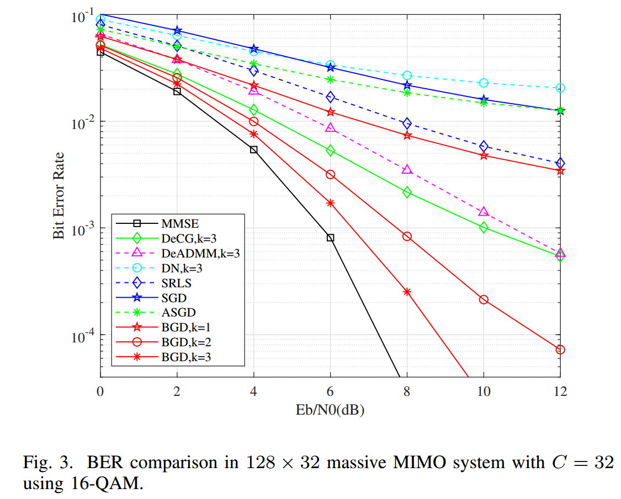
4 Simulations
Overall, the proposed BGD scheme achieves a better BER performance compared to other low-complexity distributed schemes, making it a competitive algorithm for distributed massive MIMO detection.
Notes:
performance

Slide 12
Thank you for your watching
Yunjie Chen, Qiqiang Chen, Lanxin He, Zheng Wang
Southeast University
2025.10.18

