Slide 1


Slide 2

Grid-Assisted Kalman Filter-based
Beam Tracking for Dynamic Near-Field XL-MIMO
Jikun Zhu, Zheng Wang, Zhen Gao, and Yongming Huang
Southeast University
May, 2026

Slide 3
Outline
01
Background
02
System Model
03
Proposed GKBT Scheme
04
Overhead Analysis
05
Simulation Results
06
Conclusion

Slide 4
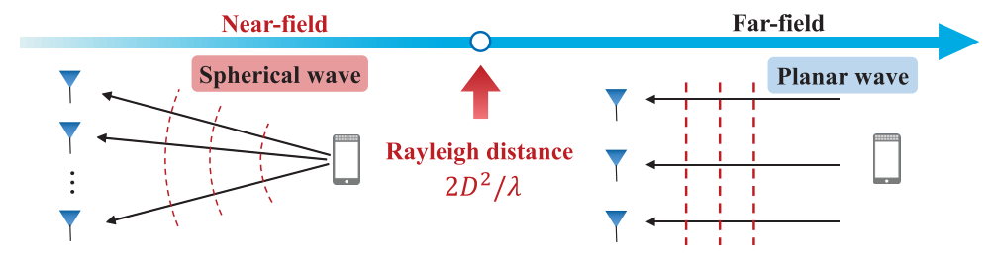
Background
Extremely Large-Scale-MIMO is a promising 6G technology due to its high spatial resolution and spectral efficiency.
The transition in electromagnetic propagation characteristics from far-field planar waves to near-field spherical waves.
Key challenge: joint search in angle and distance domains

Slide 5
Background
Motivation: From Re-Training to Tracking
Conventional dynamic handling
Proposed GKBT scheme
Train
frame 1
Train
frame 2
Train
frame 3
Train
frame 4
Initial
CHB
KF
prediction
Local
grid ML
Beam
update
Full or hierarchical beam training is re-run every frame.
After one-time initialization, proceed with low-cost tracking.
Overhead grows linearly with time frame K
Exploit temporal predictability with low overhead

Slide 6
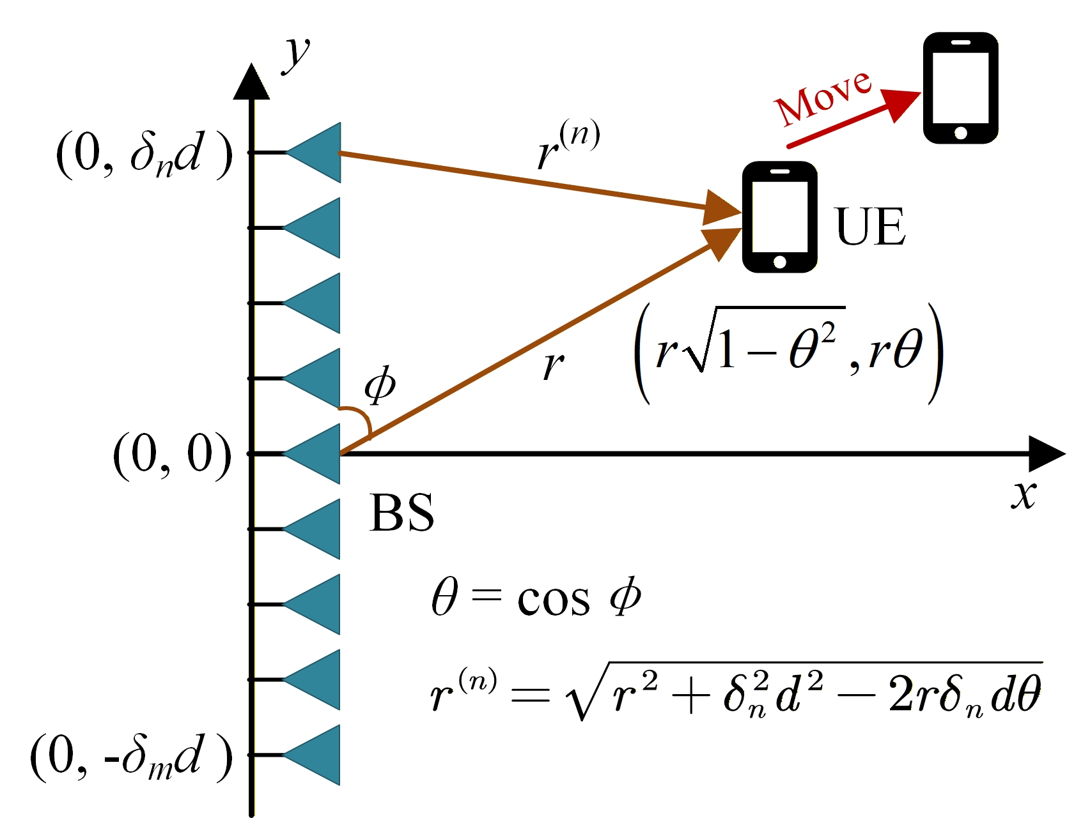
System Model: Dynamic XL-MIMO
Consider a downlink beam training XL-MIMO communication system, the base station with 𝑁 antennas communicates with a single-antenna user.
spherical-wave model
received signal at UE：
Distance：

Slide 7
System Model: Dynamic XL-MIMO
Optimal beamforming vector:
Dynamic user scenarios
Channel sequence:
At the prediction frame T+1, received signal:
Goal: select beams that stay aligned as θ and r evolve with UE mobility.

Slide 8
System Model: Problem Formulation
Polar-Domain Codebook
Exhaustive Search: find the optimal codeword to serve as the beamforming vector $v$ in the polar-domain codebook that maximizes the received signal power.
Angle–distance search space
Beam selection problem:
Exhaustive search probe N × S_{N} codewords at each frame.
High-dimensional grid
Unaffordable Beam training Overhead

Slide 9
Proposed GKBT Scheme: CHB Initialization
CHB constructs a low-dimensional near-field codebook by clustering polar-domain sampling points.
Cluster-based hierarchical near-field codebook:
cluster center
Size:
Initial beam selection:
Initial beamforming vector
Polar grid M
Cluster centers
Initial
beam alignment

Slide 10
Proposed GKBT Scheme: State and observation model
distance、angle
Motion state (slot k)
Process noise
Distance and angle’s temporal variation rates
State transition
Constant-velocity model
Location estimation in each time slot k
Local grid maximum likelihood search
An all-digital architecture results in the UE having only a single RF chain, which can only obtain limited observations through serial pilots per slot
Observation model
Measurement noise
Key Problem:
how to obtain reliable observations with low cost ?

Slide 11
Proposed GKBT Scheme: Local-Grid Assisted ML Measurement
Utilizing the prediction results from the previous round of Kalman Filter
Construct a local two-dimensional candidate grid nearby for low-cost measurement
Estimate the output position to obtain the observation model used for KF prediction
Only 9 probes for I = J = 1
Only 25 probes for I = J = 2
Use the previous rounds KF predictions for this round KF prediction.

Slide 12
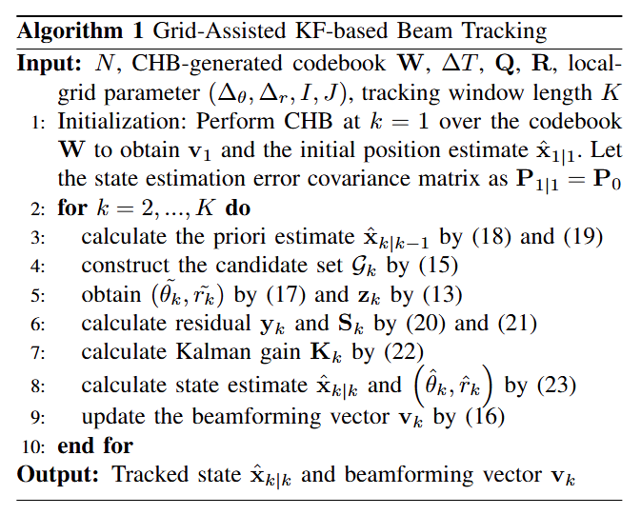
Proposed GKBT Scheme: Kalman Recursion and Beam Tracking
Prediction
Output motion state
Priori state
Beamforming vector
Covariance matrix update
Correction
Measurement residual
Residual covariance
Kalman gain
Update the filtered estimate and its covariance

Slide 13
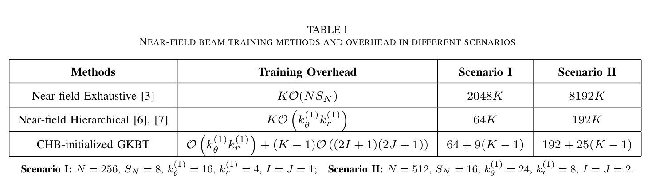
Overhead Analysis
Dynamic retraining:
Beam Tracking:
Example: Scenario II with K = 20
Exhaustive 163840 · Hierarchical 3840 · GKBT 667
GKBT strikes a favorable performance-overhead tradeoff in static near-field channels, while offering a pronounced advantage over existing methods in dynamic scenarios.

Slide 14
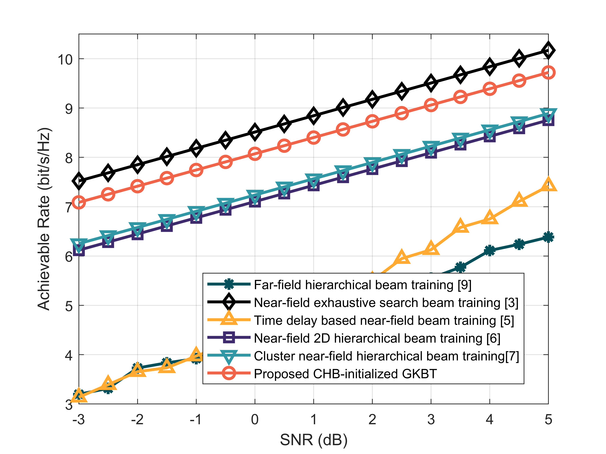
Simulation Results
Closest to the performance upper bound
Narrow-band
Parameters | Value
Carrier | 50GHz
Number of antennas | 512
Number of distance girds | 16
Rayleigh distance | 786.432 m
User distance | 20-100 m
Angle range | θ ~ U(−1, 1)

Slide 15
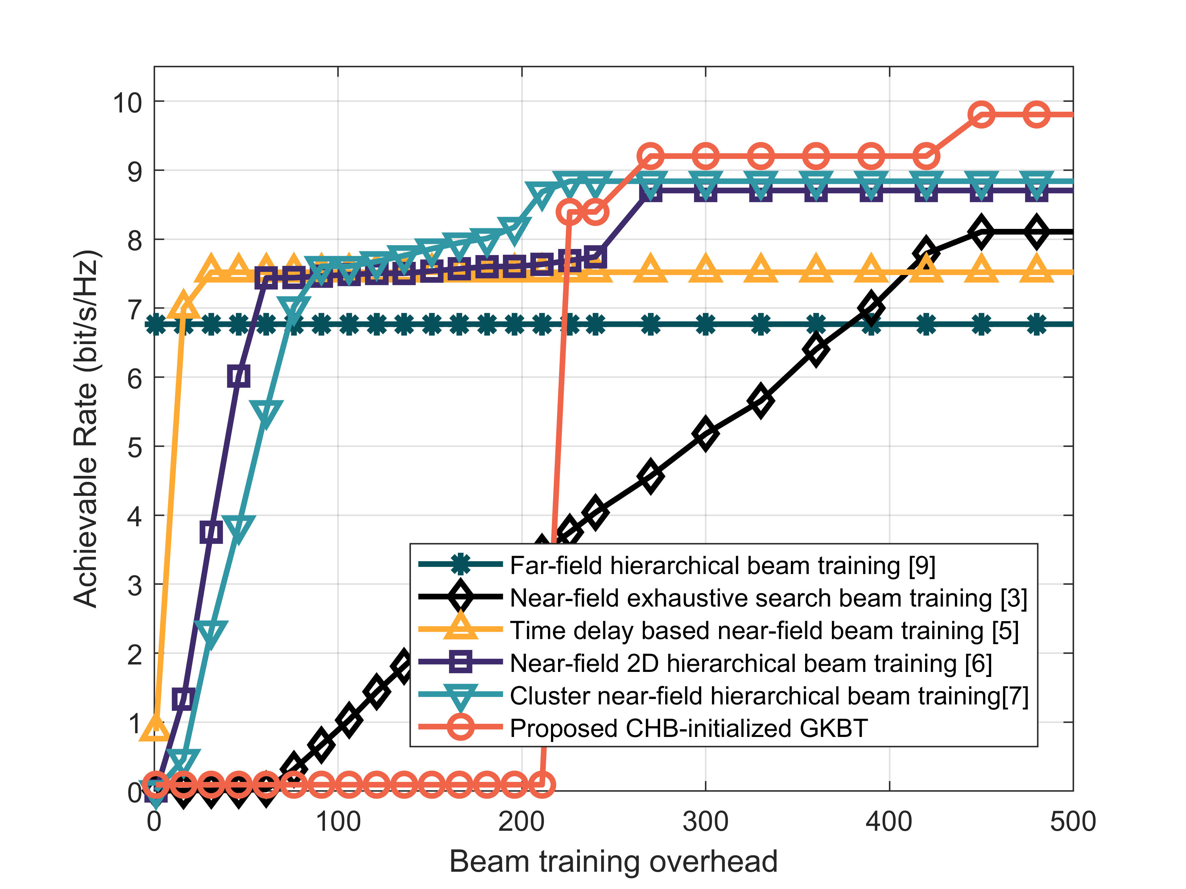
Simulation Results
GKBT overhead contains two parts: one-time CHB initialization and subsequent low-cost tracking.
•
The turning point corresponds to completing initial alignment, not steady-state tracking cost.
•
After initialization, additional overhead grows slowly because only a local grid is probed per slot.
•
GKBT reaches the high achievable rate with significantly reduced additional overhead.

Slide 16
Conclusion
Proposed GKBT
•
A grid-assisted Kalman filter-based beam tracking scheme for dynamic near-field XL-MIMO.
•
CHB is performed once for initialization, while KF recursively tracks time-varying angle and distance.
•
Local-grid ML search provides reliable observations with only a small number of pilots per slot.
Main benefits
Near-optimal achievable rate
Much lower dynamic overhead
Practical for real-time alignment

Slide 17
THANKS！
Jikun Zhu, Zheng Wang, Zhen Gao, and Yongming Huang
Southeast University
May, 2026

